Slide 1




Exploring the Effect of Multiple Natural Languages on Code Suggestion Using GitHub Copilot
Japanese
English
Chinese
[問題文] 近藤くんはXグラムの金とYグラムの銀 […] [制約] […]
[Problem Statement] Kondo melted and mixed X grams gold and Y grams […] [Constraints] […]
[问题陈述] 近藤君将A克黄金和B克白银 […] [限制条件] […]
def main():
a, b = map(int, input().split())
if a > 0 and b == 0:
print("Gold")
elif a == 0 and b > 0: […]
def main():
A, B = map(int, input().split())
if A == 0:
print("Silver")
elif B == 0: […]
def main():
a, b = map(int, input().split())
if a == 0:
print("Silver")
elif b == 0:
[…]
◎Kei Koyanagi, Dong Wang, Kotaro Noguchi, Masanari Kondo
Alexander Serebrenik, Yasutaka Kamei, Naoyasu Ubayashi
Notes:
Good morning! こんにちは，你好！
I’m kei koyanagi.
Today, we will talk about GitHub Copilot from an interesting viewpoint.
Firstly, please review these three problem statements from a programming contest.
I prepared the statements in three languages: Japanese, English, and Chinese.
There are various natural languages in the world, so this is not an unnatural problem statement.
However, GitHub Copilot only addresses problem statements in Japanese, failing to address those in both English and Chinese.
This is a motivating example. GitHub Copilot, also referred to as a large language model, is an extremely useful tool. However, it has the potential to exhibit biases based on the input prompts.
Hence, we studied the impact of multiple natural languages on code suggestion using GitHub Copilot.

Slide 2
Chinese speakers may be at a disadvantage compared to English or Japanese speakers
Message!
4.5%
16.0%
English
Japanese
Chinese
Percentage of Correctly Generated Code
in a Programming Contest
Notes:
This presentation is brief, so I'll start with the key message: Chinese speakers may be at a disadvantage compared to English or Japanese speakers.
In other words, GitHub Copilot may potentially show biases towards different natural languages in somecases.
These figures show the proportion of correctly generated code for each studied natural language.
We can see that Chinese problem statements lead the worst performance compared to other two languages.

Slide 3


Experiment
AtCoder
Japanese
English
Chinese
Software Researcher
(with 6-year experience)
Chinese
Notes:
Okay. Then, please let me show the experiment specifications briefly.
To begin with, we collected questions from Atcoder, which is one of the most popular programming contest in English, Japanese, and Chinese.
Please note that problems in Chinese has not been given by Atcoder,
so a native Chinese speaker with over five years experience in software engineering inspected all questions translated by DeepL.

Slide 4

Experiment
AtCoder
Japanese
A
B
C
D
Easy
Medium
Hard
Each difficulty has 189 problems
English
Chinese
Software Researcher
(with 6-year experience)
Chinese
Notes:
Then, each dataset has 4 different difficulties and A is similar to Easy problems on LeetCode.
B and C corresponds to medium, and D is like hard on LeetCode.
Each difficulty has 189 problems, so a dataset has 756 questions.

Slide 5

Experiment
AtCoder
Japanese
Suggestions
English
GitHub
Copilot
Suggestions
Chinese
Software Researcher
(with 6-year experience)
Suggestions
Chinese
Notes:
Then, we input these datasets into copilot, and got suggestions.
Taking into account the randomness of Copilot, recommendations were obtained five times for each question.

Slide 6

Goal: Understand how language differences affect GitHub Copilot performance
Japanese
Which language
is the best?
English
GitHub Copilot
Chinese
Notes:
Therefore, the purpose of my research is investigating how language differences affect github copilot performance using Japanese, English, and Chinese.

Slide 7

Results: Japanese recorded the highest $Accuracy$
English
Japanese
Chinese
4.5%
16.0%
5.4%
16.0%
3.4%
3.5%
13.1%
12.8%
Med.
A
Ave.
Mid.
B
Ave.
0.6%
6.2%
1.5%
7.8%
0.6%
3.2%
0.6%
3.2%
Mid.
C
Ave.
Mid.
D
Ave.
Notes:
These graphs summarize the median and average accuracies for English, Japanese, and Chinese, categorized by question difficulty.
In each graph, blue represents English, green represents Japanese, and orange represents Chinese accuracies.
According to the graph, we can find that question in Japanese was the highest accuracy in all difficulties.
Focusing on the accuracy differences between languages for Question A,
the difference between Japanese and English was 4.5%, and the difference between Japanese and Chinese was 16.0%.
Especially, the difference with Chinese was significant.

Slide 8
Results: Japanese recorded the highest $Accuracy$
English
Japanese
Chinese
4.5%
16.0%
5.4%
16.0%
3.4%
3.5%
13.1%
12.8%
Possible Reason:
AtCoder is based in Japan
and officially supports English
Med.
A
Ave.
Mid.
B
Ave.
0.6%
6.2%
1.5%
7.8%
0.6%
3.2%
0.6%
3.2%
Mid.
C
Ave.
Mid.
D
Ave.
Notes:
This is an intriguing result. I believe many of you anticipated that English would yield the best performance.
One reason is that our target data comes from AtCoder, which is based in Japan.
Also, AtCoder officially supports English.
This implies that the training data for GitHub Copilot might contain more Japanese and English data, leading to this result.

Slide 9
Results: Japanese recorded the highest $Accuracy$
English
Japanese
Chinese
Message#1
English is not always better
4.5%
16.0%
5.4%
16.0%
3.4%
3.5%
13.1%
12.8%
Possible Reason:
AtCoder is based in Japan
and officially supports English
Med.
A
Ave.
Mid.
B
Ave.
Message#2
Chinese speakers may be at a disadvantage compared to English or Japanese speakers
0.6%
6.2%
1.5%
7.8%
0.6%
3.2%
0.6%
3.2%
Mid.
C
Ave.
Mid.
D
Ave.
Notes:
To sum up, I show two key messages.
First, English is not always better.
Second, Chinese speakers may be at a disadvantage compared to English or Japanese speakers

Slide 10
Summary: The capability varies across natural languages.
Contact:
Email: kondo@ait.kyushu-u.ac.jp
Twitter: @masanari_kondo
Notes:
This is the summary slide.
Thank you for all.

Slide 12
Results: Japanese recorded the highest $Accuracy$
English
Japanese
Chinese
68.1%
54.3%
Med.
A
Ave.
Mid.
B
Ave.
28.9%
11.0%
Mid.
C
Ave.
Mid.
D
Ave.
Notes:
These graphs summarize the median and average accuracies for English, Japanese, and Chinese, categorized by question difficulty.
In each graph, blue represents English, green represents Japanese, and orange represents Chinese accuracies.
According to the graph, we can find that questions in Japanese was the highest accuracy in all difficulties.
And the accuracy of A difficulty questions was 68.1%

Slide 13
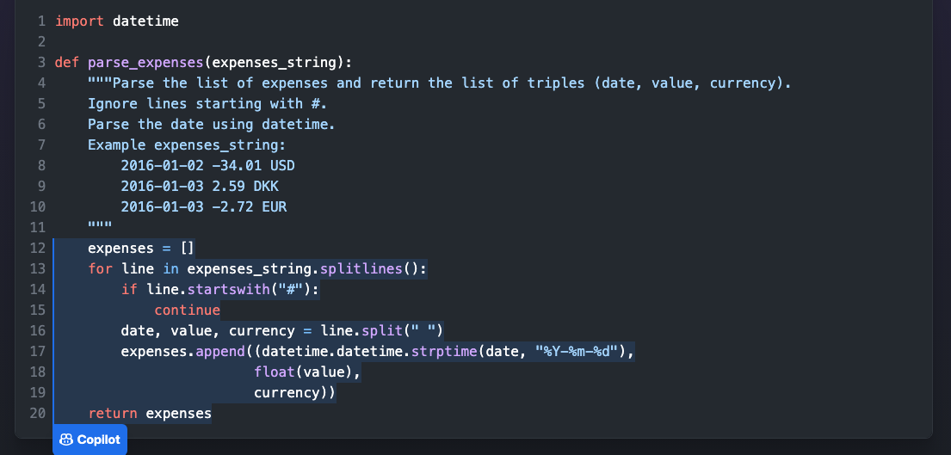
Background: Development using AI
GitHub Copilot (Coding Support)
Input
Recommendation
Notes:
These days, most people have developed applications, using various tools.
Github copolit is one of the coding support tools, and some of you may use it.
It suggests code snippets and libraries in different programming languages to developers based on
comments that describe specifications and the code being written.
This shows a screen shot of the actual coding support.
copilot recommends the code according to the input.
At first, we describe what we want to do in this process.
In this picture, the blue text represents it.
Then, copilot regards the comment as input, and this tool recommends the code according to it.

Slide 14

Background: The effect of input language
GitHub Copilot
Input
Output
Correct Answer
in English
Wrong Answer
in Japanese
We should give appropriate input to use AI efficiently.
Notes:
However, this method has still many problems.
One of the issues is the effect of input language.
For instance, if we input comment in English, we will get correct answer.
On the other hand, if we input in Japanese, we may receive wrong answer.
Thus, we should give appropriate input to leverage artificial intelligence efficiently,
but we have had no idea about what language is the most suitable for each task.

Slide 15

Exploring the Effect of Multiple Natural Languages on Code Suggestion Using GitHub Copilot
◎Kei Koyanagi, Dong Wang, Kotaro Noguchi, Masanari Kondo
Alexander Serebrenik, Yasutaka Kamei, Naoyasu Ubayashi
Notes:
Hello everyone
I’m kei koyanagi.
Today, I will talk about my paper, Exploring the effect of multiple natural languages on code suggestion using github copilot

Slide 16
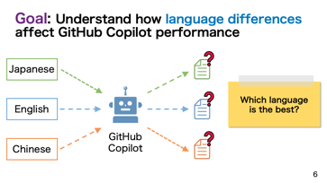
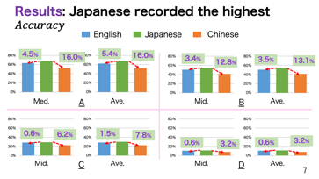
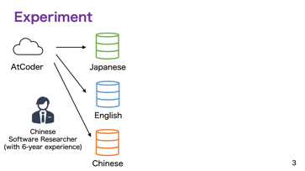
Summary: The capability varies across natural languages.
Notes:
This is the summary slide.
Thank you

Slide 17
Summary: The capability varies across natural languages.
Notes:
As the result, Japanese was the highest score compared to English and Chinese.
This is the remarkable consequence because it is known empirically that English is the best.
Of course, I need to experiment with additional dataset because this research only focused on specific data.
In brief, I have discussed the background, the purpose, and the result of my research.
This research would contribute to more efficient use of artificial intelligence, which would cut development costs in half.
That’s all. Thank you for listening.
As the root, it is unclear what language to use, and uncovering the difference of three input language is the objective.
Moreover, Japanese was the best in this research consequently, but additional experiment is still needed.

Slide 18
Result (Precision)
Japanese
English
Chinese
68.1%
63.6%
52.1%
Remarkable consequence
(it is known empirically that English is the best)
I need to experiment with additional dataset.
Notes:
As the result, Japanese was the highest score compared to English and Chinese.
This is the remarkable consequence because it is known empirically that English is the best.
Of course, I need to experiment with additional dataset because this research only focused on specific data.
In brief, I have discussed the background, the purpose, and the result of my research.
This research would contribute to more efficient use of artificial intelligence, which would cut development costs in half.
That’s all. Thank you for listening.
As the root, it is unclear what language to use, and uncovering the difference of three input language is the objective.
Moreover, Japanese was the best in this research consequently, but additional experiment is still needed.

